Slide 1
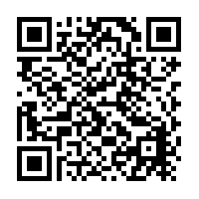
Do you DIG bio?
Join the Hoover Herbarium for an international volunteer event, without even leaving campus!
Fisher Science Hall (33) Room 258
Friday, October 18, 2019
12:10 PM
1:10 PM
2:10 PM
3:10 PM
Stay as long as you’d like!
Games | Prizes RSVP online at https://tinyurl.com/wedigbio
Space is limited!

Slide 2
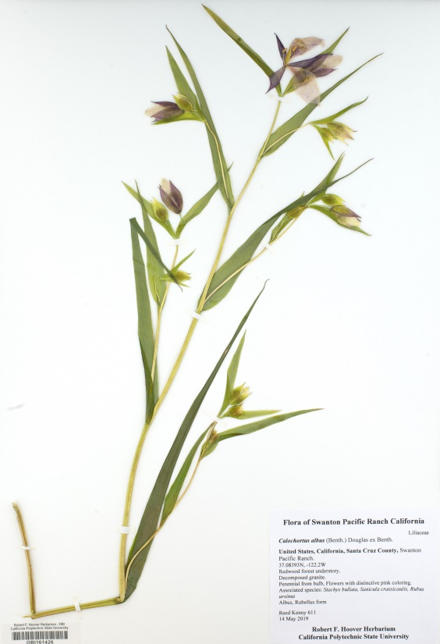
Do you DIG plants?
Thousands of plant specimens remain largely undiscovered. Help bring vital data to light by participating in a worldwide “digitization” event.
October 14-17, 2021
Join on your own time at NotesFromNature.org
OR join a synchronous virtual event.
For more information, visit:
or email ????????????????
www.capturingcaliforniasflowers.org/wedigbio
www. wedigbio.org/find-a-project

Slide 3
Do you DIG plants?
Thousands of plant specimens remain largely undiscovered. Help bring vital data to light by participating in a worldwide “digitization” event.
October 14-17, 2021
You could win a FREE STICKER by participating at
NotesFromNature.org
or by joining a synchronous virtual event.
For more information and to sign up, visit:
CapturingCaliforniasFlowers.org/wedigbio
or email ????????????

